Slide 1

Planning and Analysis for Solar Energy
in Libya
Mohamed Abuella
Department of Electromechanical Engineering
College of Industrial Technology, Misurata, Libya
كلية التقنية الصناعية، مصراتة، ليبيا
July 19th, 2021

Slide 2
Variability of Solar Energy Resources
Solar Energy Modeling
Presentation Outline
Capacity Factor of Solar Energy Resources
Aggregation of Solar Energy Resources

Slide 3
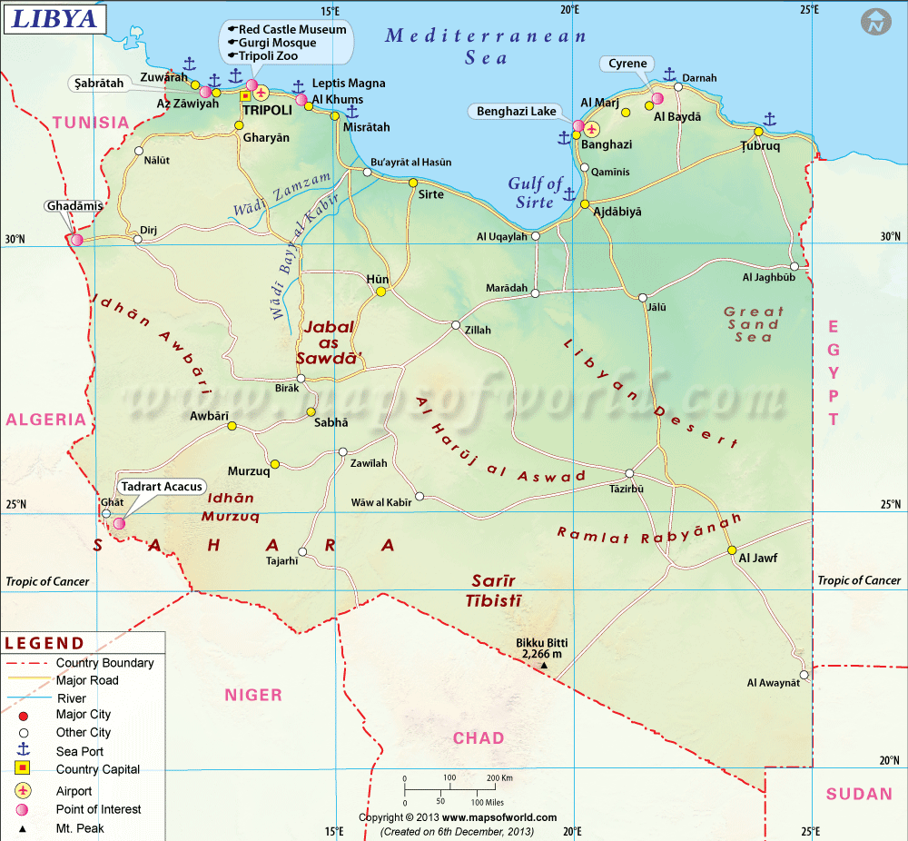
Solar Energy Analysis for Some Locations in Libya
9 Locations for Comparison of Solar Energy Modeling and Analysis:
Tripoli, Misurata, Sirte, Benghazi, Derna, Houn, Gadamis, Sebha, Kufra
Typical Meteorological Year (TMY) data represents the weather for a "median year”.
Data are retrieved from NREL’s Developer Network: https://developer.nrel.gov/

Slide 4
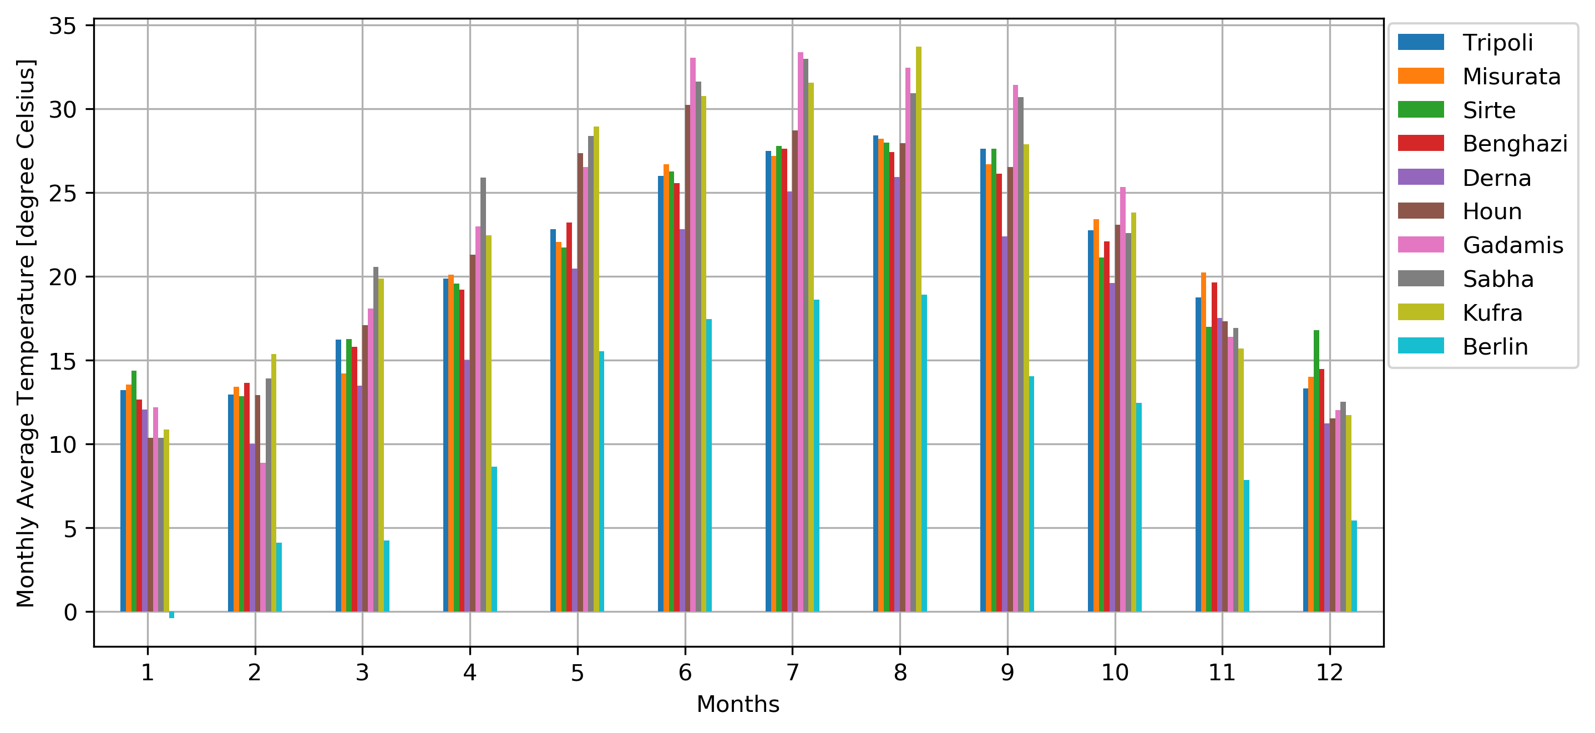
Comparison of Monthly Average Temperature, in degree Celsius (ºC)
Berlin in Germany has been added just for sake of comparison.

Slide 5
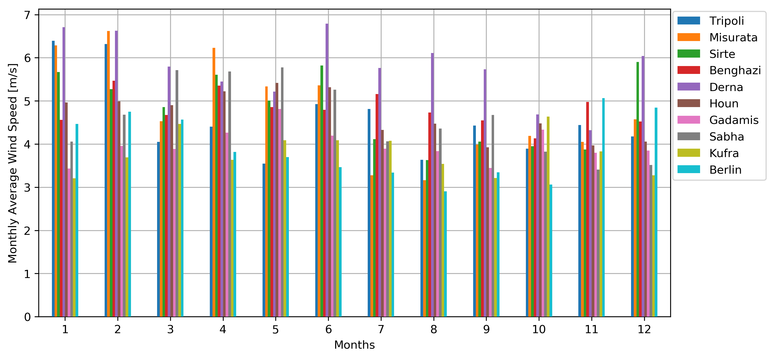
Comparison of Monthly Average Wind Speed, in meter per second (m/s)

Slide 6
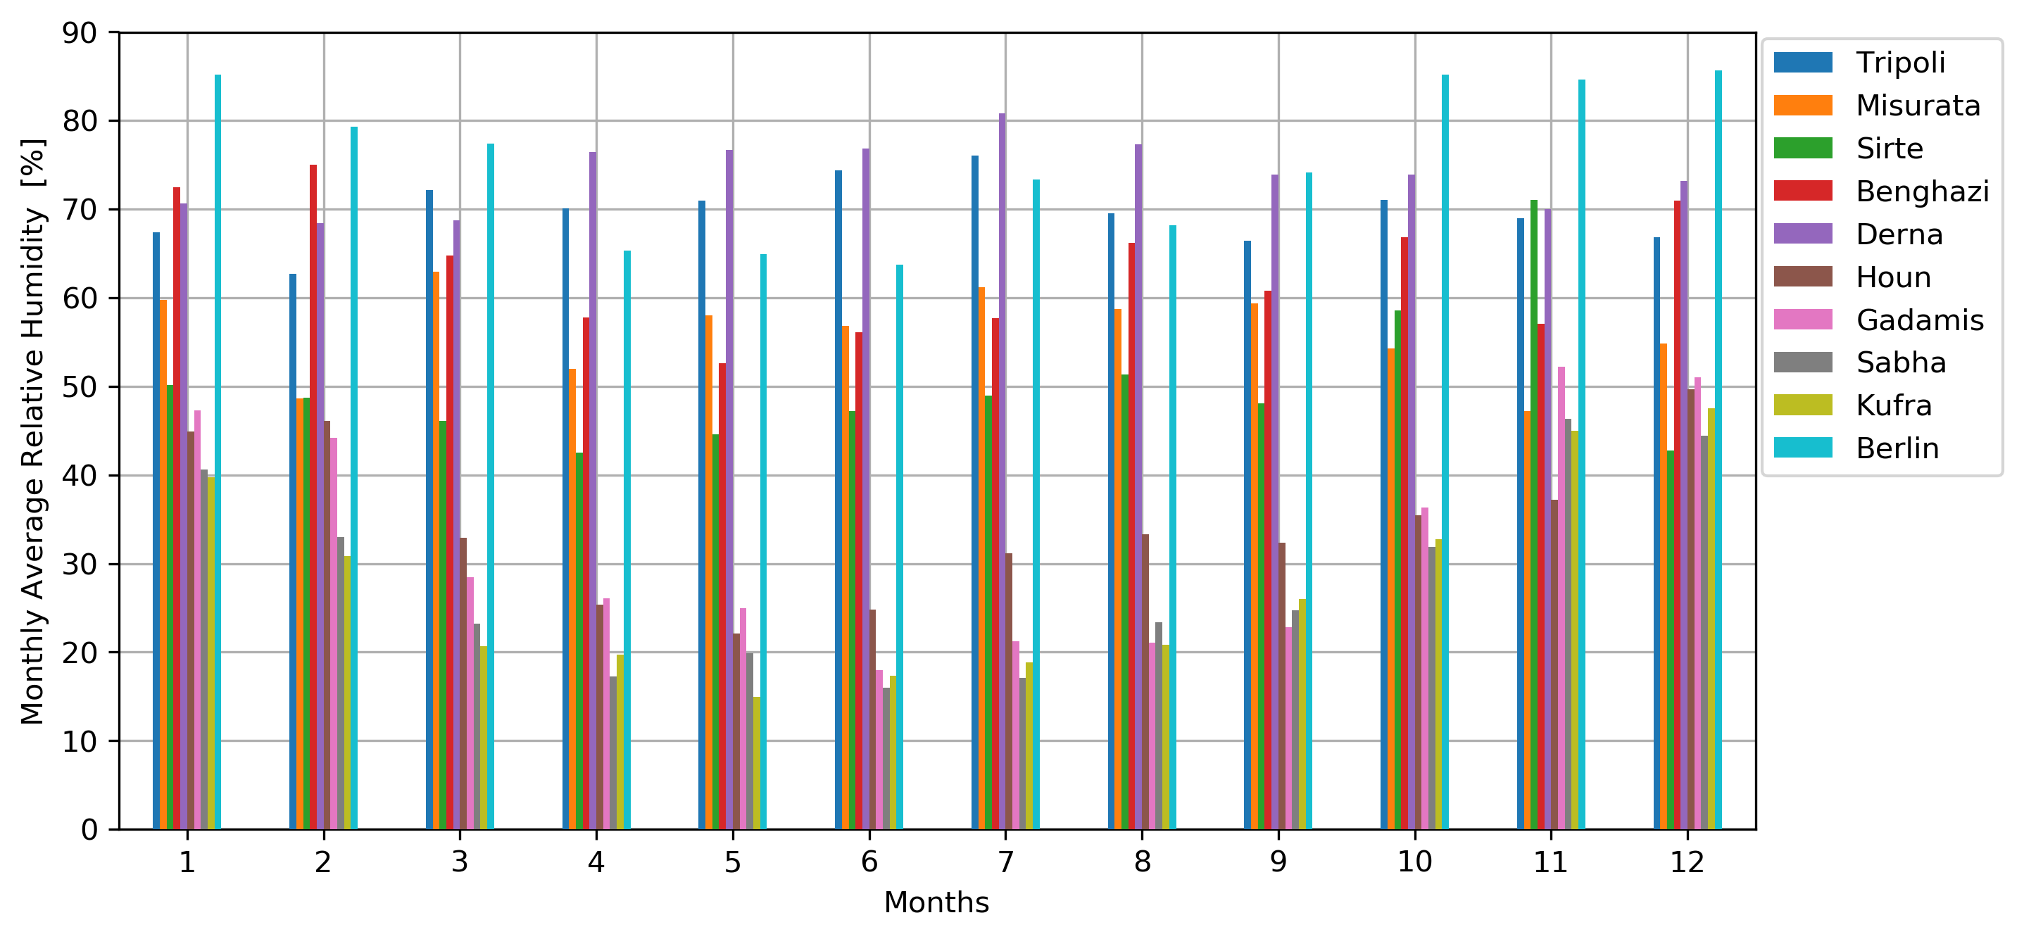
Comparison of Monthly Average Relative Humidity, in percentage (%)

Slide 7
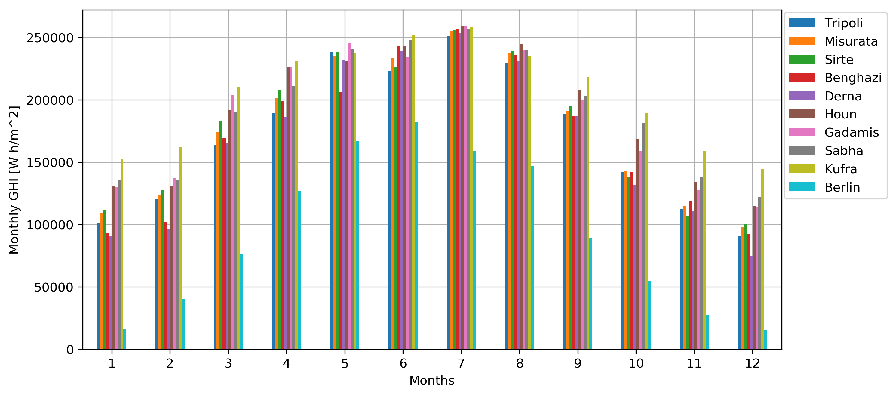
Comparison of Solar Energy by the Global Horizontal Irradiance (GHI), Watt-Hour accumulated monthly per Square-Meter, (Wh/m²)
Berlin in Germany has been added just for sake of comparison.

Slide 8
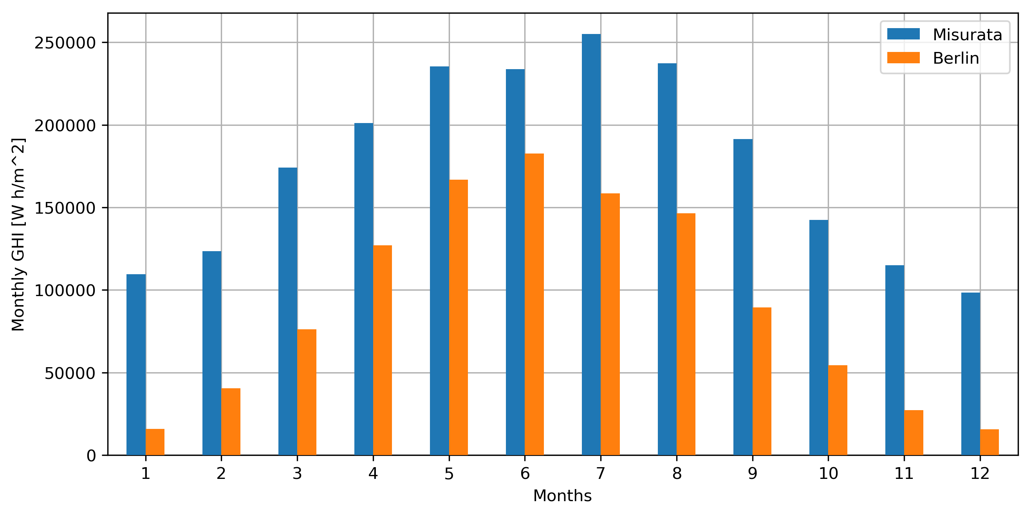
Comparison of Solar Energy by the Global Horizontal Irradiance (GHI), Watt-Hour accumulated monthly per Square-Meter, (Wh/m²)
Comparison between Misurata, Libya and Berlin, Germany

Slide 9
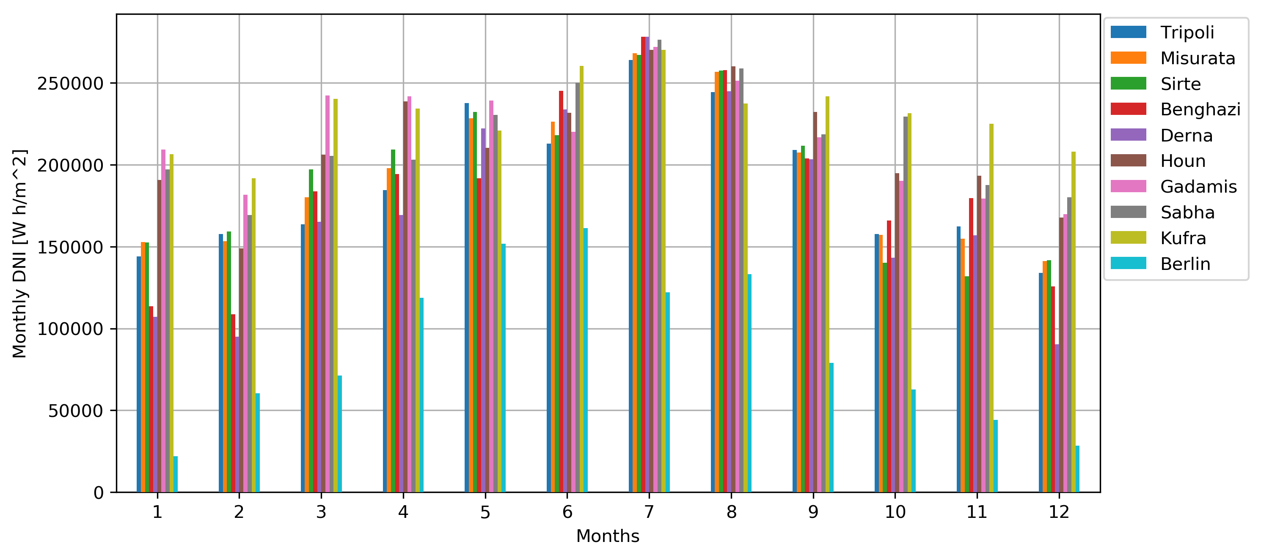
Comparison of Solar Energy by the Direct Normal Irradiance (DNI), Watt-Hour accumulated monthly per Square-Meter, (Wh/m²)

Slide 10
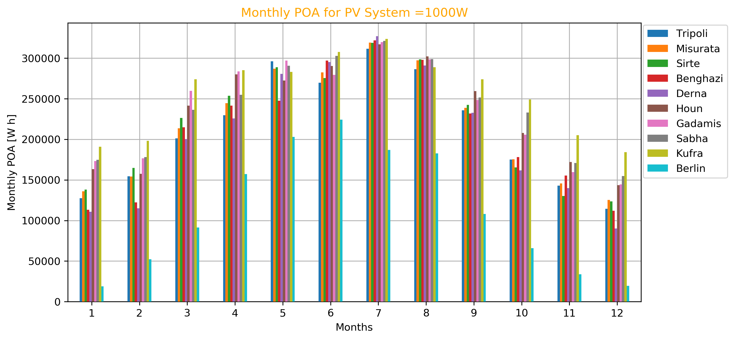
Comparison of Solar Energy by the Plane of Array (POA),
Watt-Hour accumulated (Wh) for PV system of rating PW=1000W
The POA irradiance is modeled for solar panels with double-axis orientated, in other words, with optimal tilt and azimuth angles at each locations, for a Solar PV System with capacity of 1000W.

Slide 11
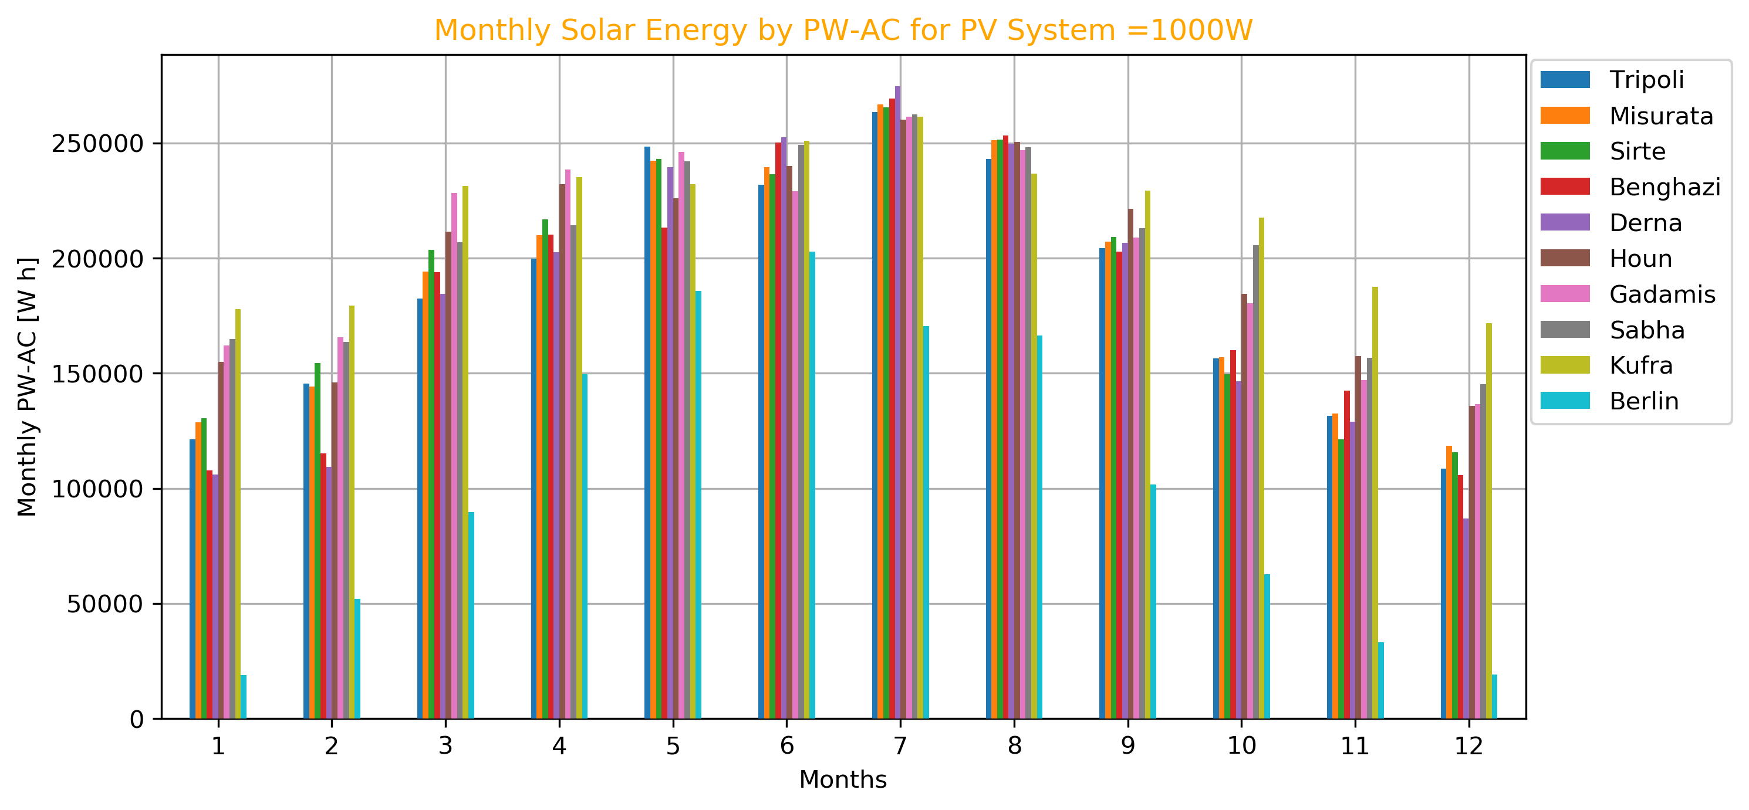
Comparison of Solar Energy by an Output Power AC-PW (PWac),
Watt-Hour accumulated (Wh) for PV system of rating PW=1000W
The POA irradiance is modeled for solar panels with double-axis orientated, in other words, with optimal tilt and azimuth angles at each locations, for a Solar PV System with capacity of 1000W.

Slide 12
Comparison of Net Capacity Factors (NFC)
The Capacity Factor is calculated based on Several Irradiances and Output Powers (DC) and (AC).
The Rating of Solar PV System =1000W during an entire year = 8760 hours.
Location | GHI_CFs | POA_CFs | PWDC_CFs | PWAC_CFs | DNI_CFs | POA_DNI_CFs
Tripoli | 0.234199 | 0.290585 | 0.269381 | 0.255352 | 0.259360 | 0.221591
Misurata | 0.241662 | 0.299089 | 0.276883 | 0.261649 | 0.265344 | 0.226979
Sirte | 0.243338 | 0.299912 | 0.278514 | 0.262380 | 0.264714 | 0.228497
Benghazi | 0.233556 | 0.289290 | 0.269182 | 0.253993 | 0.256688 | 0.220415
Derna | 0.228293 | 0.282047 | 0.265982 | 0.249833 | 0.240903 | 0.210889
Houn | 0.260896 | 0.320580 | 0.294575 | 0.276308 | 0.290568 | 0.250722
Gadamis | 0.259906 | 0.324995 | 0.295710 | 0.279878 | 0.298431 | 0.255136
Sabha | 0.262925 | 0.327496 | 0.298587 | 0.282232 | 0.297604 | 0.258812
Kufra | 0.279635 | 0.349891 | 0.317157 | 0.298130 | 0.316106 | 0.278651
Berlin | 0.125719 | 0.153390 | 0.149713 | 0.143000 | 0.120461 | 0.094420

Slide 13
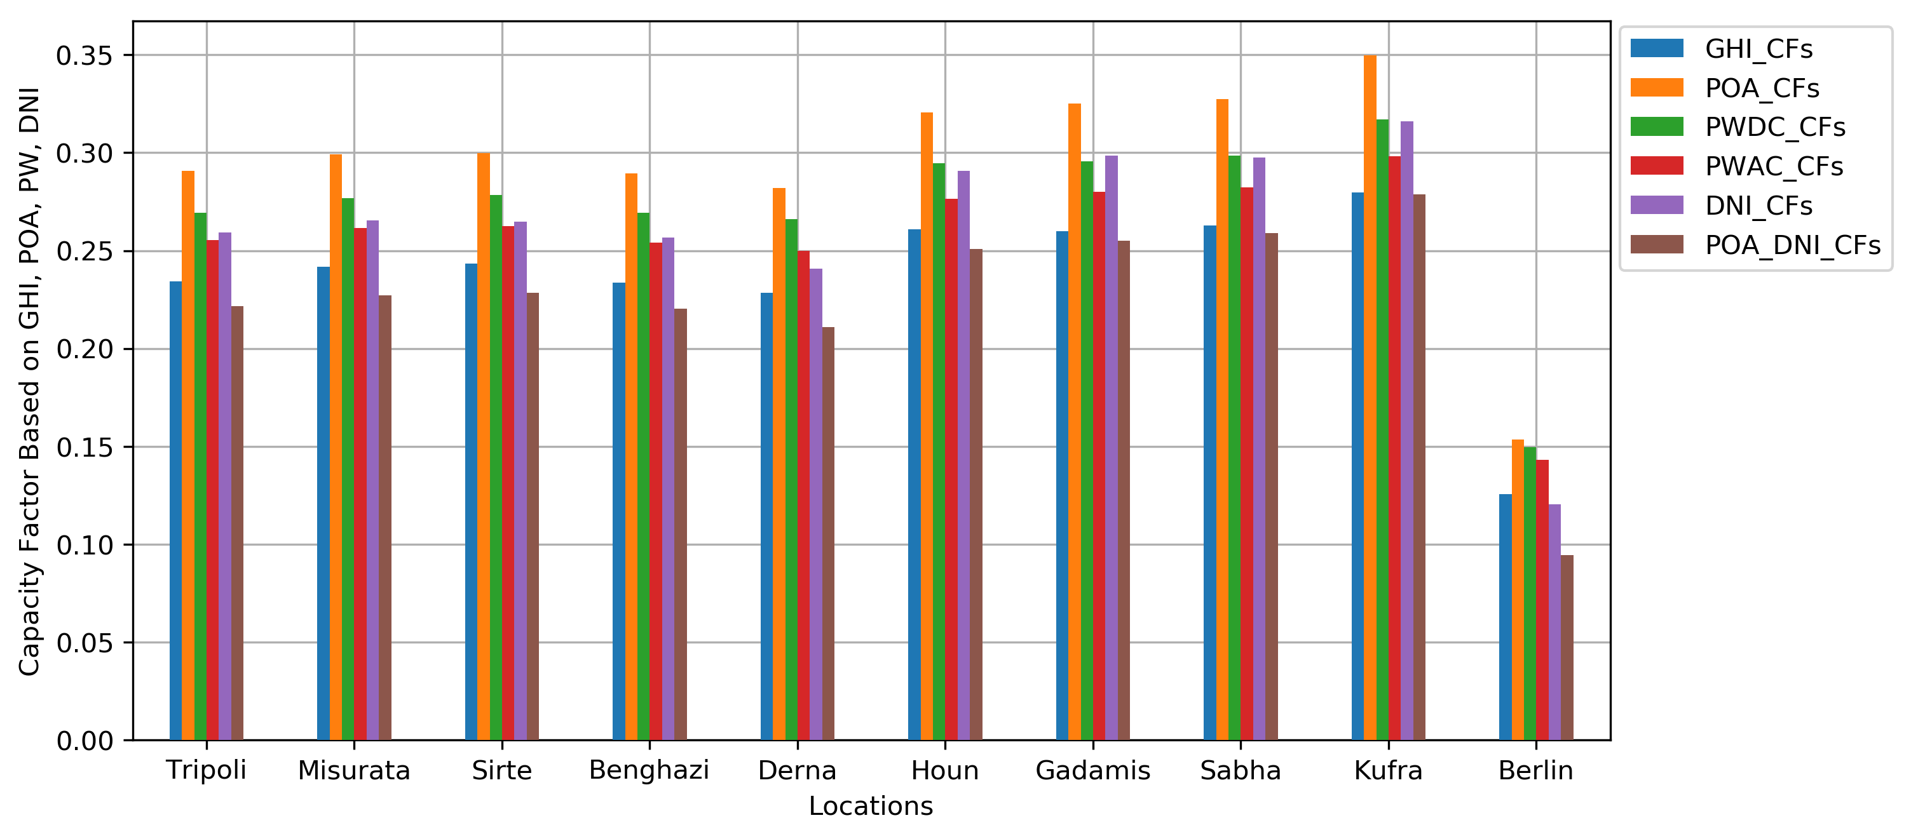
Comparison of Net Capacity Factors (NFC)
The Capacity Factor is calculated based on Several Irradiances and Output Powers (DC) and (AC).
The Rating of Solar PV System =1000W during an entire year = 8760 hours.

Slide 14
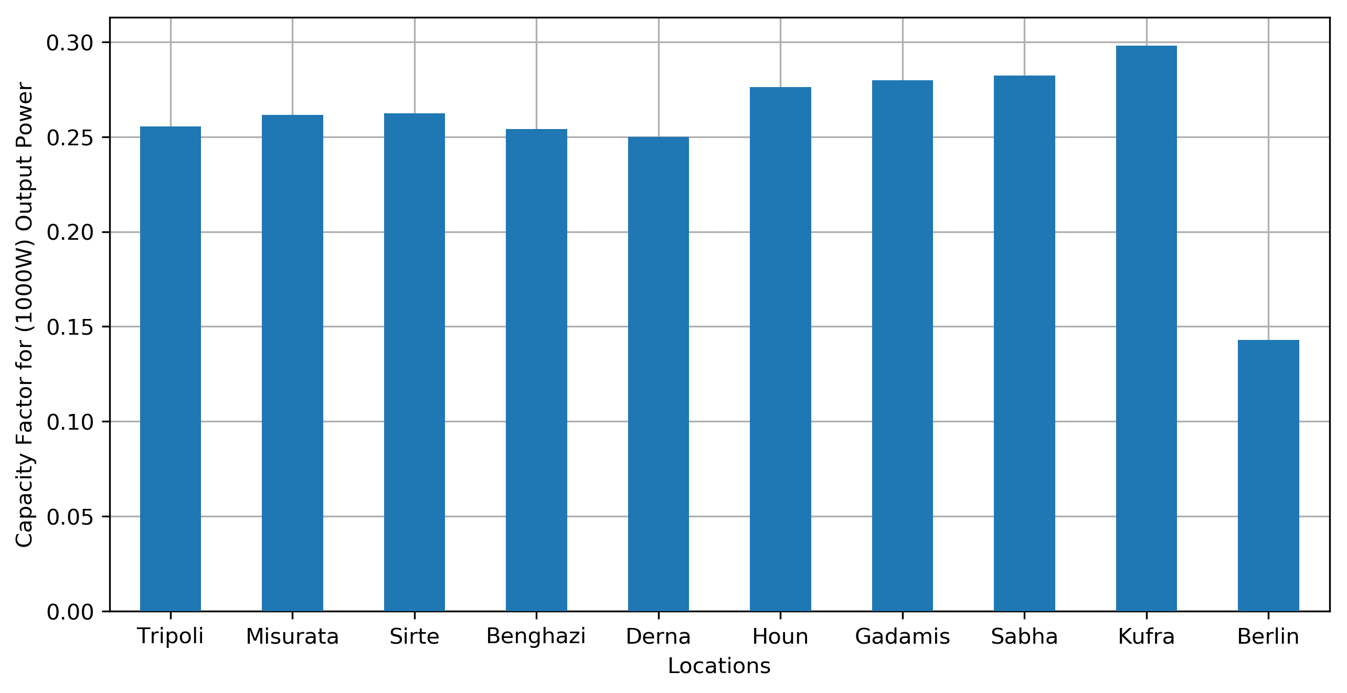
Comparison of Net Capacity Factors (NFC)
The Capacity Factor is calculated based on Output power (PWac).
The Rating of Solar PV System =1000W during an entire year = 8760 hours.

Slide 15
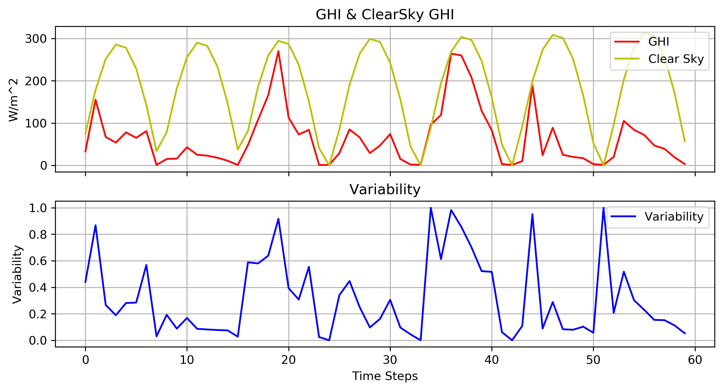
Comparison of Solar Power Variability
The Variability solar energy at a given location is determined based on the irradiance deviation from the clear-sky irradiance, (GHI/Cl-GHI).

Slide 16
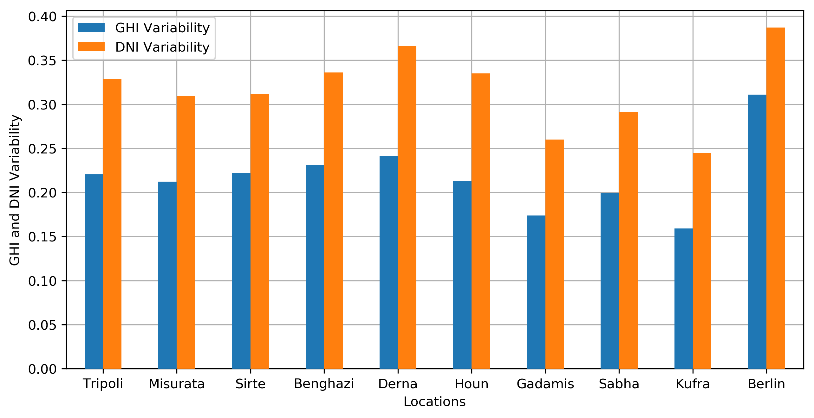
Comparison of Solar Power Variability
The Variability solar energy at a given location is determined based on the irradiance deviation from the clear-sky irradiance. The standard deviation of this (GHI/Cl-GHI) or (DNI/Cl-DNI) is used as an indication to the solar variability at a given location.

Slide 17
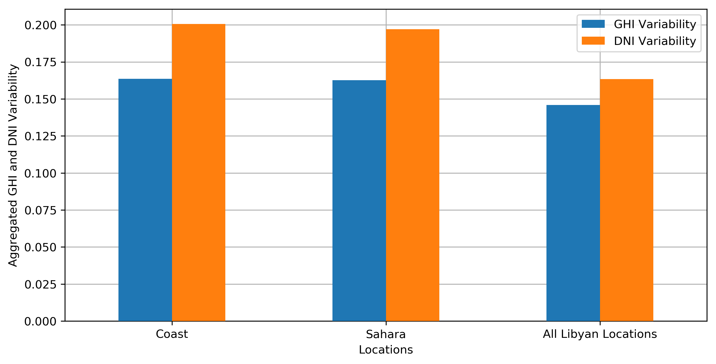
Comparison of Aggregated Solar Power Variability
The solar resources are aggregated based to their locations:
Coast Region: Tripoli, Misurata, Sirte, Benghazi, Derna.
Sahara Region: Houn, Gadamis, Sabha, Kufra.
and the All Locations: Tripoli, Misurata, Sirte, Benghazi, Derna, Houn, Gadamis, Sabha, Kufra.

Slide 18
Improvement of Variability Due to Aggregated Solar Resources
The solar resources are aggregated based to their locations:
Coast Region: Tripoli, Misurata, Sirte, Benghazi, Derna.
Sahara Region: Houn, Gadamis, Sabha, Kufra.
and the All Locations: Tripoli, Misurata, Sirte, Benghazi, Derna, Houn, Gadamis, Sabha, Kufra.
GHI_Improvement at Aggregated Locs=(1 - (Agg GHI_var/min_Agg_Var@Region))*100
Improvement (%) | Agg vs. Best Coast | Agg vs. Best Sahara | Agg vs. Best All
Coast | 22.866774 | -2.955564 | -2.955564
Sahara | 23.329008 | -2.338584 | -2.338584
All | 31.228778 | 8.205837 | 8.205837
DNI_Improvement at Aggregated Locs=(1 - (Agg DNI_var/min_Agg_Var@Region))*100
Improvement (%) | Agg vs. Best Coast | Agg vs. Best Sahara | Agg vs. Best All
Coast | 35.079876 | 18.053005 | 18.053005
Sahara | 36.248064 | 19.527579 | 19.527579
All | 47.168813 | 33.312558 | 33.31255

Slide 19
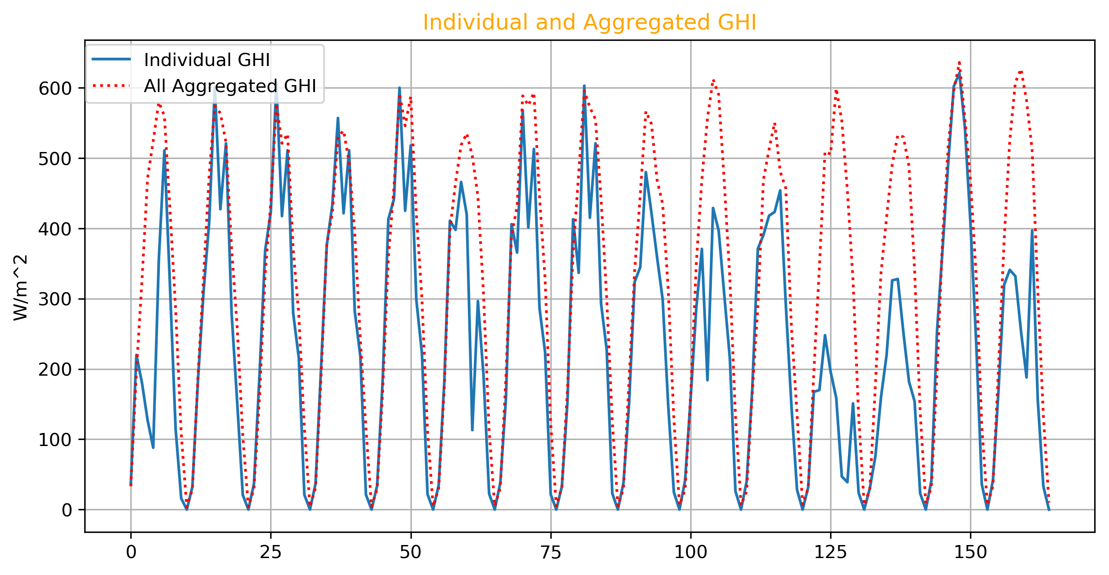
Visualization of Aggregated Solar Power Variability
The solar resources are aggregated based to their locations:
Aggregated All Location against an individual location is Derna
During days from January 1st to January 15th

Slide 20
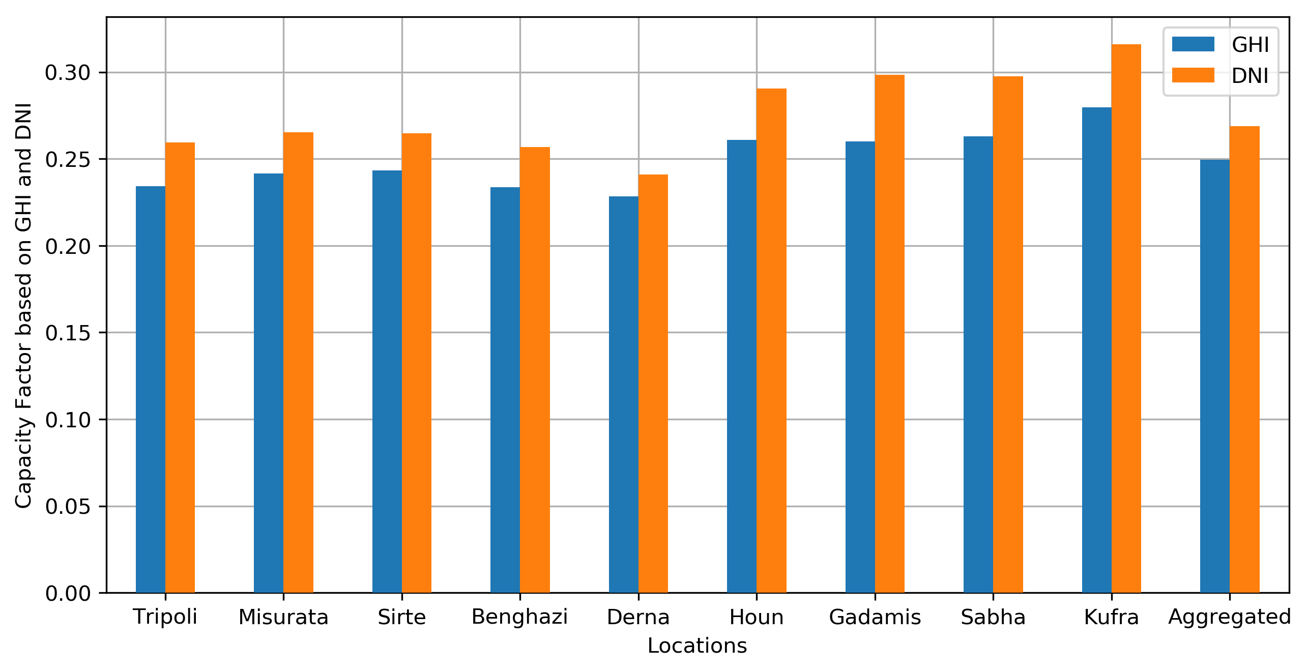
Net Capacity Factor for Aggregated Locations
The aggregated net capacity factor for all aggregated locations:
and the All Locations: Tripoli, Misurata, Sirte, Benghazi, Derna, Houn, Gadamis, Sabha, Kufra.

Slide 21
Net Capacity Factor for Aggregated Locations
The aggregated net capacity factor for all aggregated locations:
and the All Locations: Tripoli, Misurata, Sirte, Benghazi, Derna, Houn, Gadamis, Sabha, Kufra.
NCF based on GHI
Net Capacity Factor based on GHI for All Aggregated Locations=0.249
While Average Net Capacity Factor based on GHI=0.237
And Max Net Capacity Factor based on GHI=0.279 @ Kufra location
NCF based on DNI
Net Capacity Factor based on DNI for All Aggregated Locations=0.269
While Average Net Capacity Factor based on DNI=0.261
And Max Net Capacity Factor based on DNI=0.316 @ Kufra location

Slide 22
Conclusions
In Libya, the southern locations yield more solar energy, but the northern locations have a good yielding compared to some locations in the world with significant solar power deployment.
The average net capacity factor is about 0.30, and it can be considered high for solar power plants.
The variability of the Coast locations is higher than the southern “Sahara” locations, which means a need for more auxiliary services at the coast region, such as more energy storage.
The aggregation of Coast, Sahara, and All locations leads to a reduction in the variability and slightly increasing the capacity factor.
Aggregation different solar plants from various regions can lead to more enhancement in solar power deployment.

Slide 23
Thanks for Listening
Any Question?
Mohamed Abuella
mabuella@cit.edu.ly
https://mohamedabuella.github.io
http://epic.uncc.edu/

